Slide 1


Software Engineering Department, Ort Braude College
Capstone Project – Phase 2, 61998
Hidden homology detection via the protein connectivity network analysis _ 23-2-R-13.
Student name: Fadi Harb.
ID: 316239151.
Supervisor: Dr. Zakharia Frenkel
GIT link : https://github.com/fadih1996/Hidden-homology-detection-via-the-protein-connectivity-network-analysis_FinalProject

Slide 2
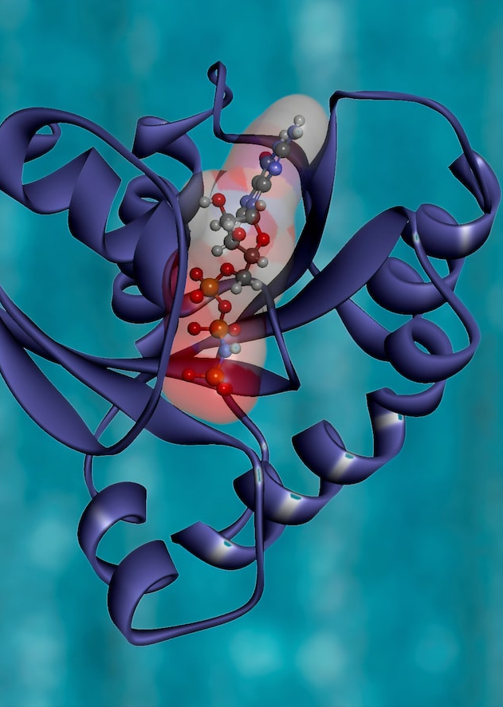

Introduction
• protein homology detection is a known bioinformatics problem
•Predicting unknown protein/ peptide's structure
Notes:
Tיגדכגד

Slide 3

BackGround
• Proteins – Peptides
• Protein Connectivity Network (PCN)
• UniProt DataBase

Slide 4
TATA-BOX
The "TATA box" is a DNA sequence that is crucial in the process of gene transcription in many eukaryotic organisms. While it is not a feature of proteins directly, it plays a significant role in the synthesis of proteins by influencing the transcription phase of gene expression.

Slide 5
NAPD
The acronym "NAPD" could be associated with a typo or confusion with the more commonly referenced molecule "NADP+" in the context of biochemistry and molecular biology. "NADP+" stands for Nicotinamide Adenine Dinucleotide Phosphate, which is crucial in cellular metabolism and not a protein itself but often tightly interacts with proteins.

Slide 6
PCN
•Protein Connectivity network is exhibited by a graph to show the framework.
• Our study uses a network to represent similarity between short sequences
• Nodes represent 20 amino acid segments, and edges represent similarity.
The size of the PCN might vary depending on the number of proteins used to build it; for instance, a network made up of 320,000 proteins will result in 92,000,000 nodes of 20 amino acid fragments.

Slide 7
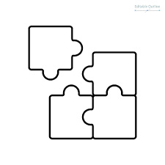
Algorithms and computational system
• K_mismach algorithm
• Graph analysis algorithm GraphAligner

Slide 8
Relate work
• NetworkBLAST
NetworkBLAST uses a special algorithm to match proteins based on how they connect in a network
• HMM-HMM COMPARISON
the most sensitive methods employ HMM-HMM comparison, which models a protein family using HMM (Hidden Markov Model) and then detects homologs using HMM-HMM alignment.
HMM cannot model long-range residue interaction patterns and thus carries very little information regarding the global 3D structure of a protein family.

Slide 9

WORK PLAN
• Exploring and recognizing
• Definition of the Research Objective
• Preparing the Protein Database
• Implementations
• Analyzing Results and Identify Hidden Homologies

Slide 10
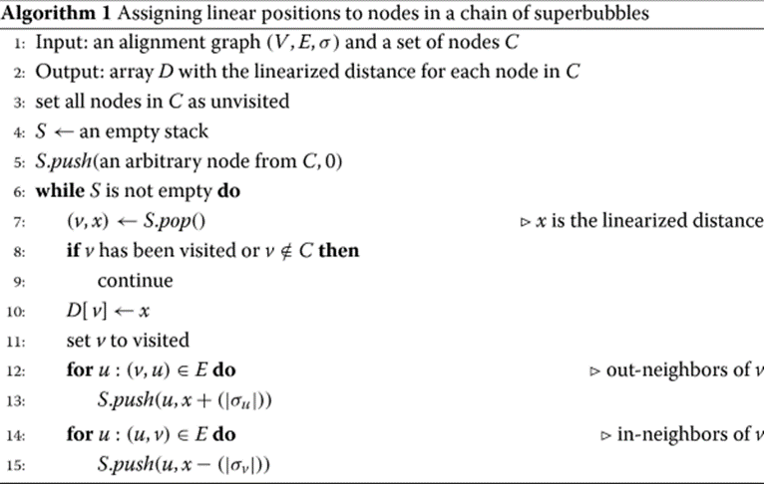
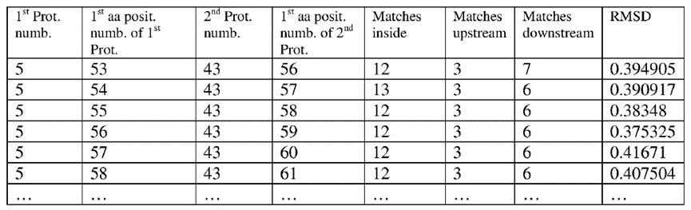
Detailed Implementation steps & Software Engineering
(a) Obtaining a protein network.
(b) Generating training data.
(c) Generating a weighting function derived from training data values.
(d) Applying said weighting function to a protein network.
• The GraphAligner algorithm
• Training Data
Example of training data table

Slide 11
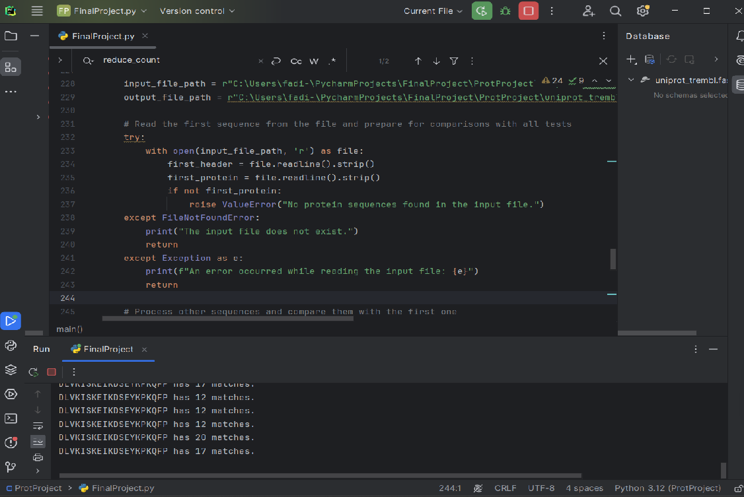
Detailed Implementation steps & Software Engineering
Because the database is very large (128 GB) the run took more than a week for the code to finish running and give results, while the code shows me the comparison results while

Slide 12
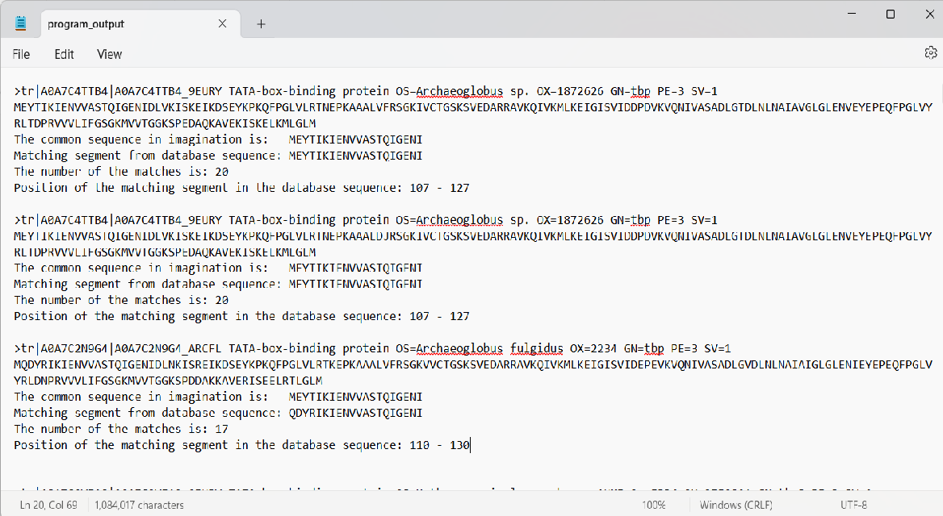
Detailed Implementation steps & Software Engineering
Step 1
In step A we will compare with all the proteins in the database with K=8 mismatches

Slide 13
Detailed Implementation steps & Software Engineering
Stage 2
In step 2 consists of 3 sub-stages, we will refer to the first sequence we received in the previous stage, and compare it with all the given sequences, if there is more than one different letter we will read the sequence to the next stage, after that if there are more than two letters, and after that 3 letters, In this way we filtered out the similar proteins

Slide 14
Detailed Implementation steps & Software Engineering
Stage 3
At this stage we have almost reached the end, after the filtering we will separate two main types, (TATA-BOX) & (NAPD) and thus we will get final results, that is, here we will draw a conclusion and which proteins from each group are similar and have connective functionality between each other.

Slide 15
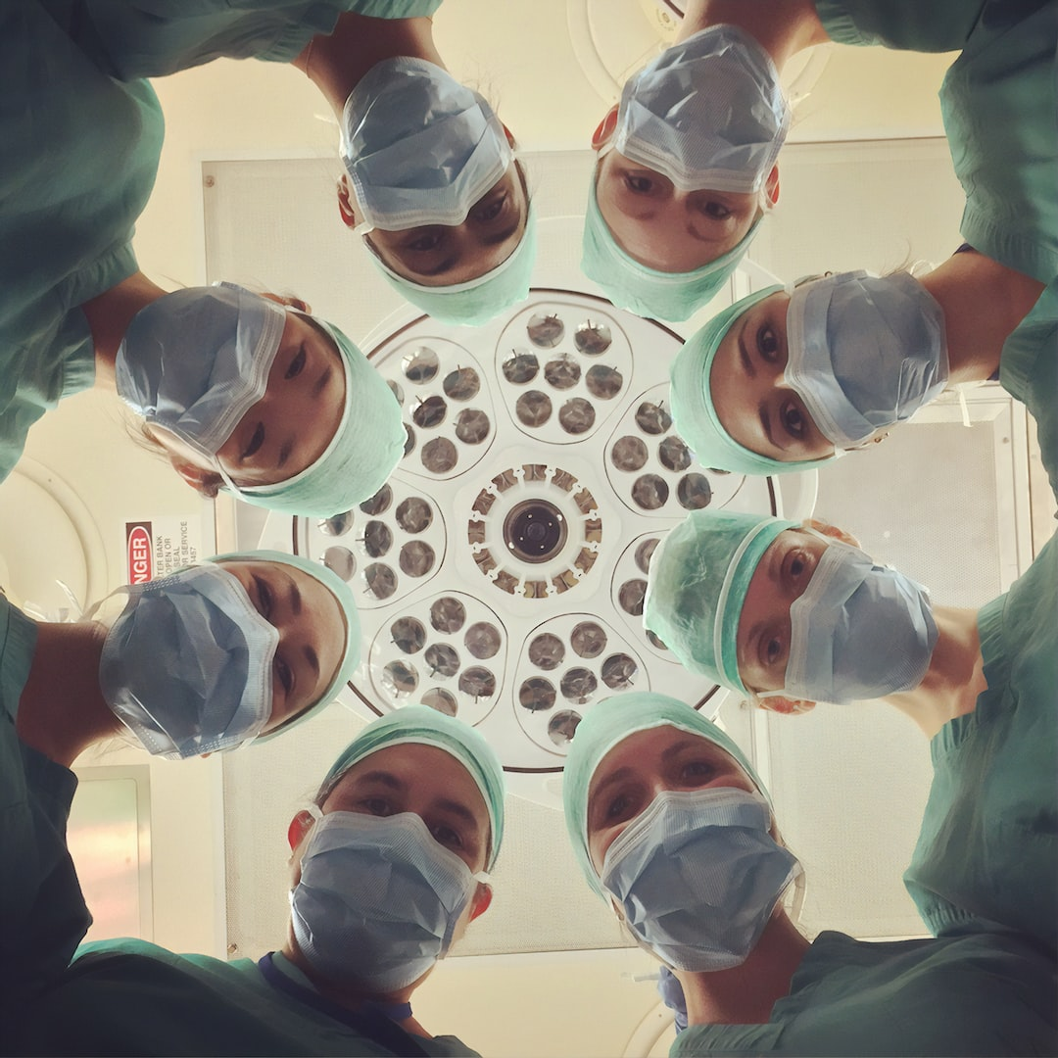
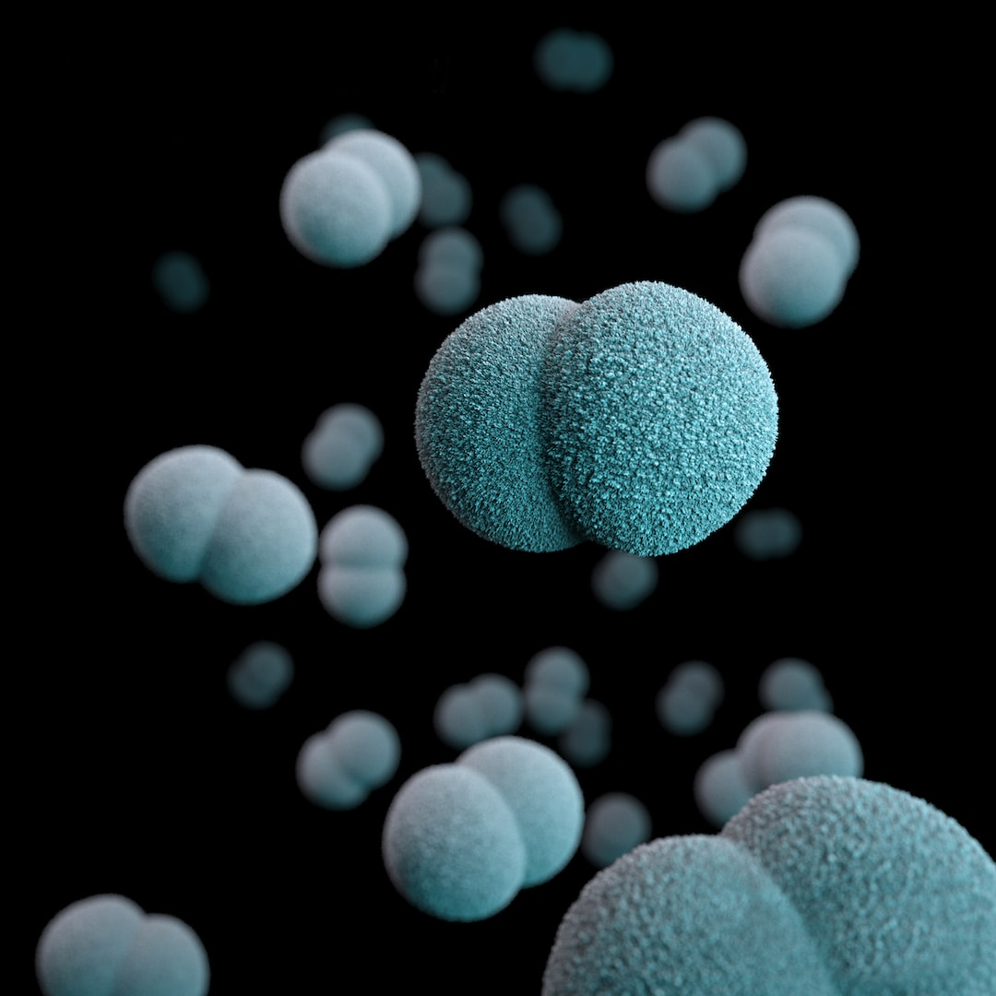

Conclusion
Notes:
עכגדכגע

Slide 16
Thanks for listening !

